Slide 1

Python assignment

Slide 2
Data source
The data collected was collected from a single person study conducted by a bunch of university students.
This data was collected for 30 days.
This data was collected through fitbit watch where it’s worn by the client ( test subject ) while sleeping to collect data such as overall sleep score, deep sleep in minutes and more.
The data were also collected through the use of telegram bot where the client inputs the coffee intrake throughout the day.

Slide 3
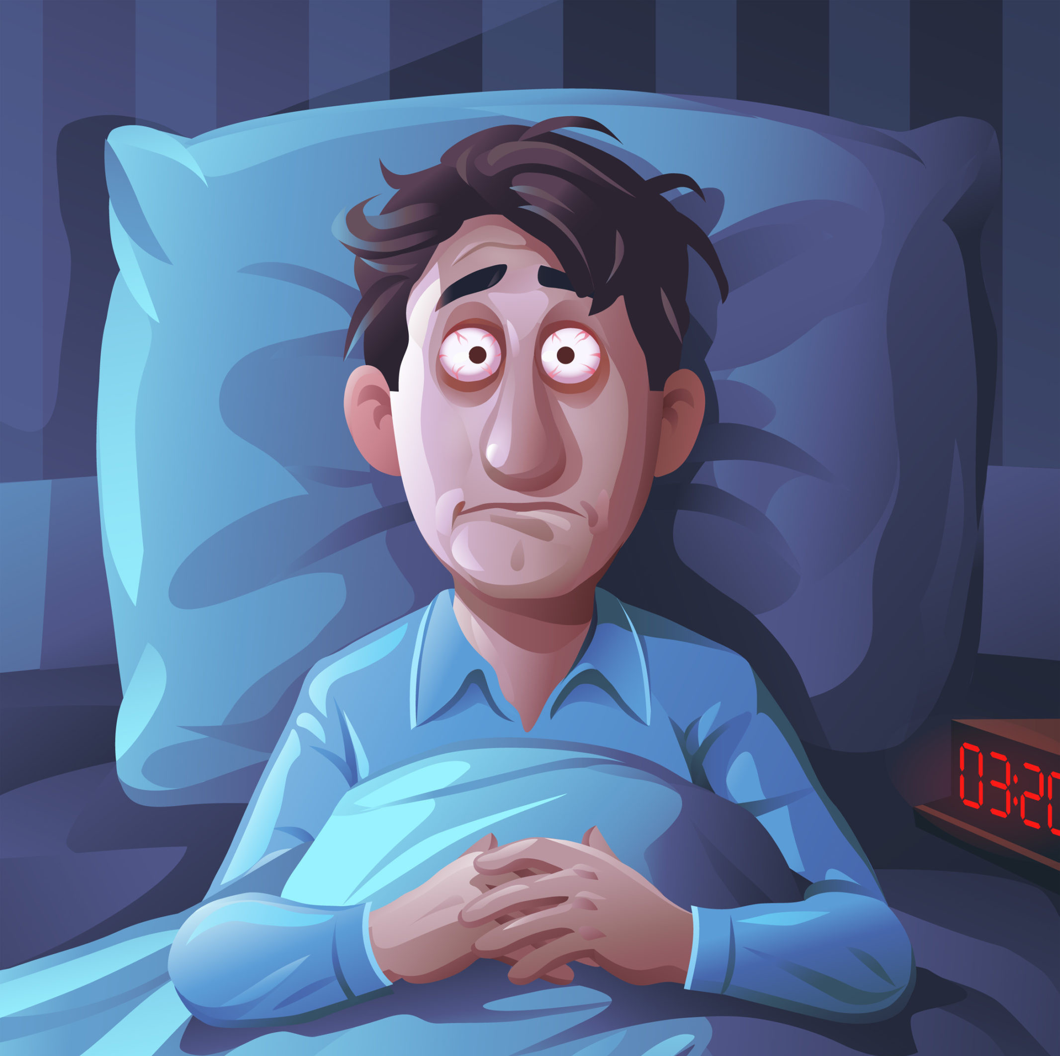
Aim of the data analysis
We aim to find strong correlations and improve the sleep of our client.
After finding strong correlations estimated to 0.7 we can conduct results on what affects what.

Slide 4
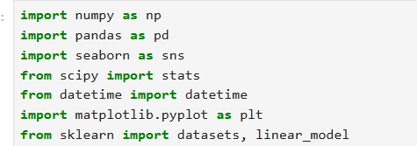
Data analysis
import section.
We imported libraries that we will use in this data analysis it’s the first step into any data analysis

Slide 5

Importing our data set
We imported our data set using the panda library
We have this data already saved in our computer and copied the path of it here then using the read function and saving it into data variable

Slide 6
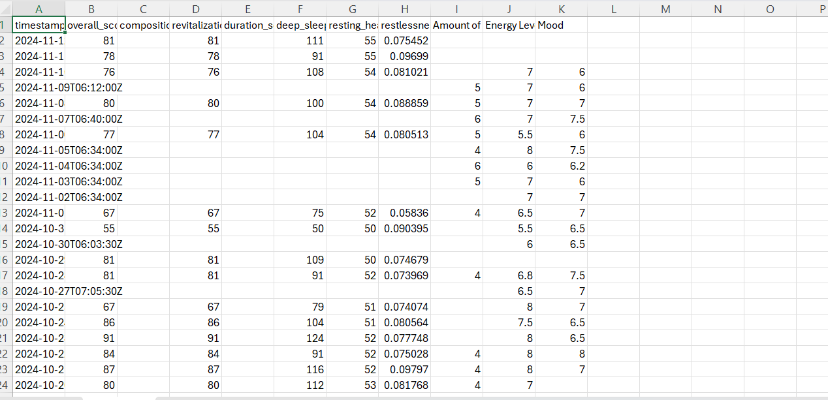
Our data
This data looks uncleaned and it has a lot of missing values due to the client not wearing the fitbit on some days and the missing values is conducted as NaN
Now our job is to fix and clean this data and fill missing values.

Slide 7
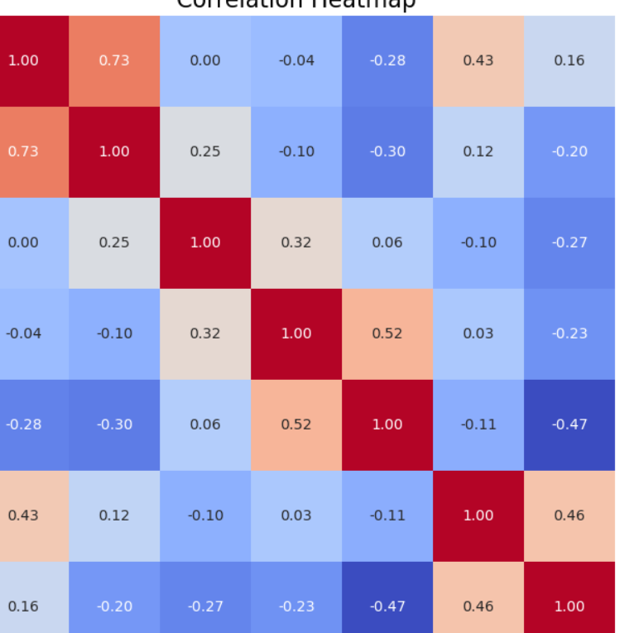
Checking for correlation in the uncleaned data
We checked for correlations using the heatmap to gain insights if we do have correlations or not to check the nature of data and not ruin it
We can say that we have a strong correlation between overall score and deep sleep in minutes with the value of 0.73

Slide 8
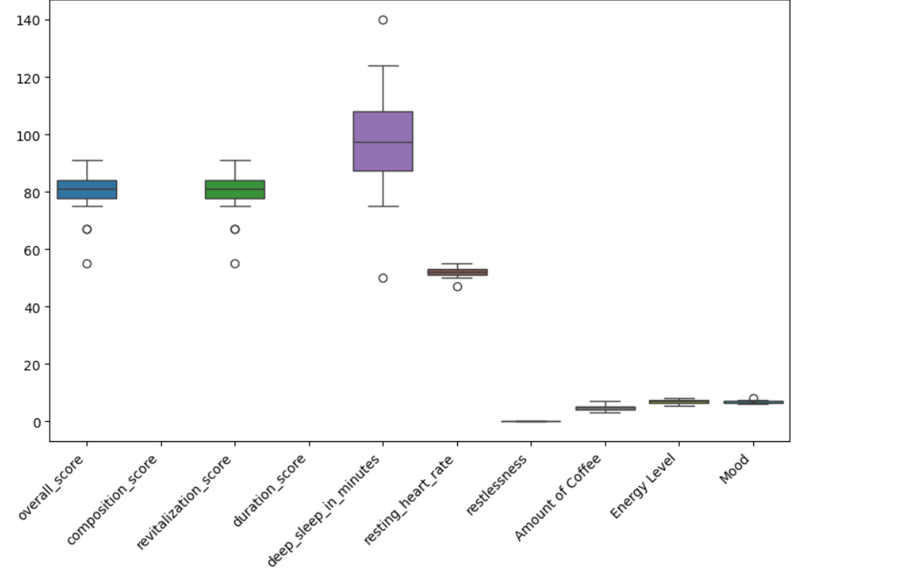
Checking for outliers
We create a boxplot using the sns library to check if there’s outliers to handle them and weather we want to handle them or not.
We can see that we have few dots that represent outliers in each column

Slide 9
Handling outliers
We decided to not remove the outliers due to them being a machine data (fit bit device) and there could not be a error in the entry of the data.
So the reason we have an outlier is probably because of some other factors and removing these outliers will ruin the data analysis and accuracy.

Slide 10
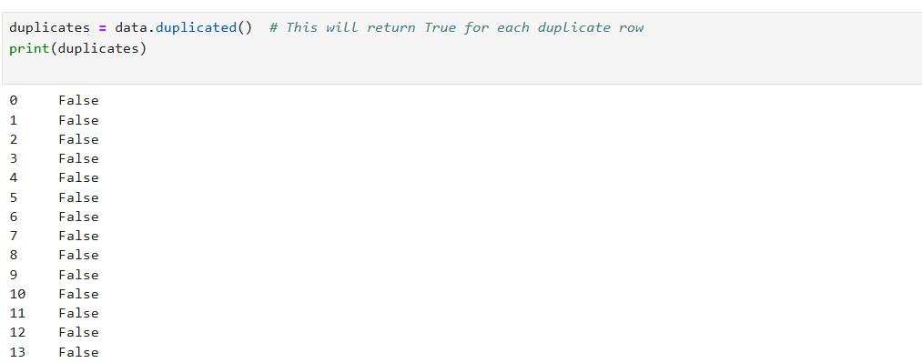
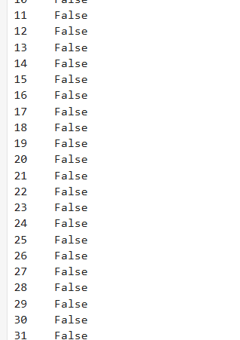
Checking for duplicates
We checked for duplicates using duplicated() function it will return true if we have duplicates
We can see that there’s no duplicates due to all the rows being False so we don’t have to do any extra steps.

Slide 11
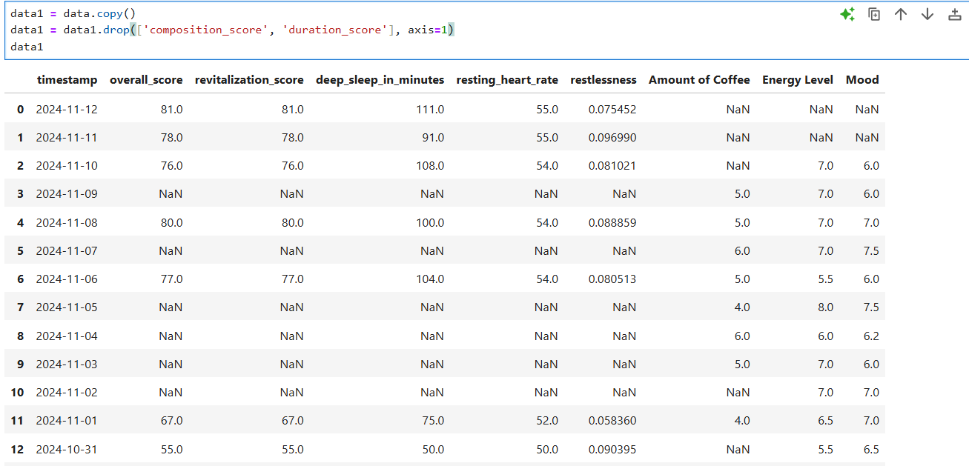
Dropping empty rows that has no data
We realized that our data had entire rows with missing data so we decided to drop them using the drop function.
We created a copy into data1 not to ruin the original data

Slide 12
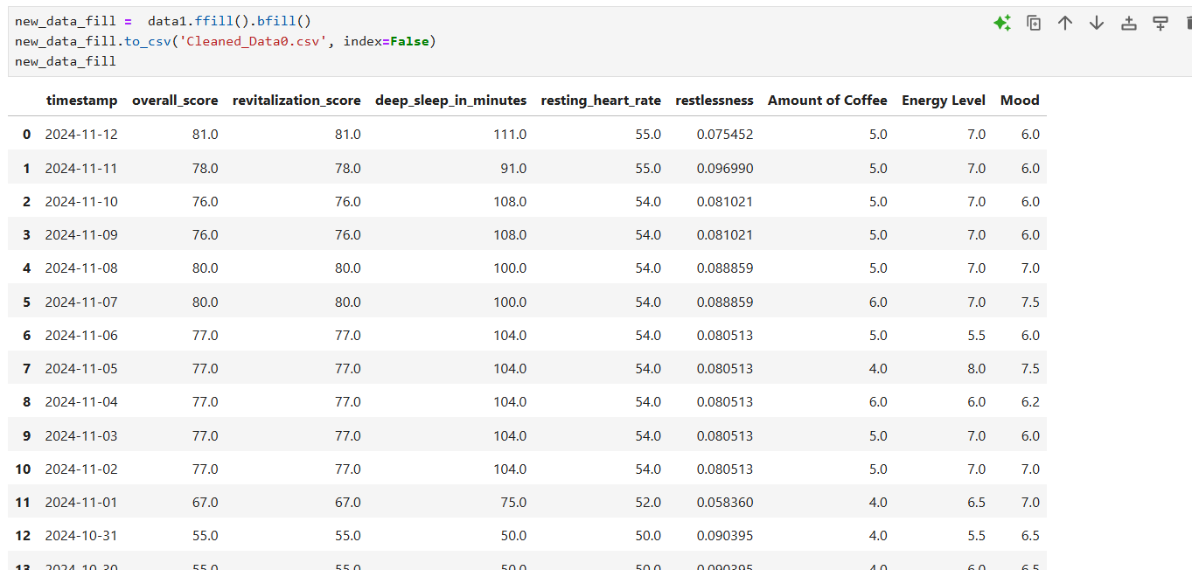
Filling the missing values
We decided to fill the missing values not remove them to ensure accuracy on our data analysis and not ruin correlations.
We used the fillbfill method due to it being a time series data rather than using other methods like mean or median.
We saved the data at a new csv file called “Cleaned_data0”

Slide 13
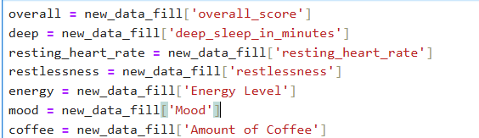
Storing variables in a easy access way

Slide 14
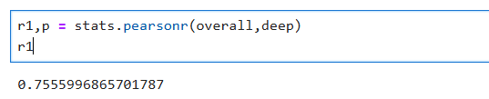
Calculating Pearson correlations.
We calculated Pearson correlations between deep sleep and overall score because we suspected earlier that we had a strong linear relationship between them both so we check the value
As mentioned earlier our study focuses to find relationship on what affects the client overall sleep score so we are going to aim on overall and deep sleep in minutes since it has a strong correlation
After looking at the value of the correlation we can see that it hasn’t changed much from before cleaning the data and filling missing values so we are on the right path

Slide 15
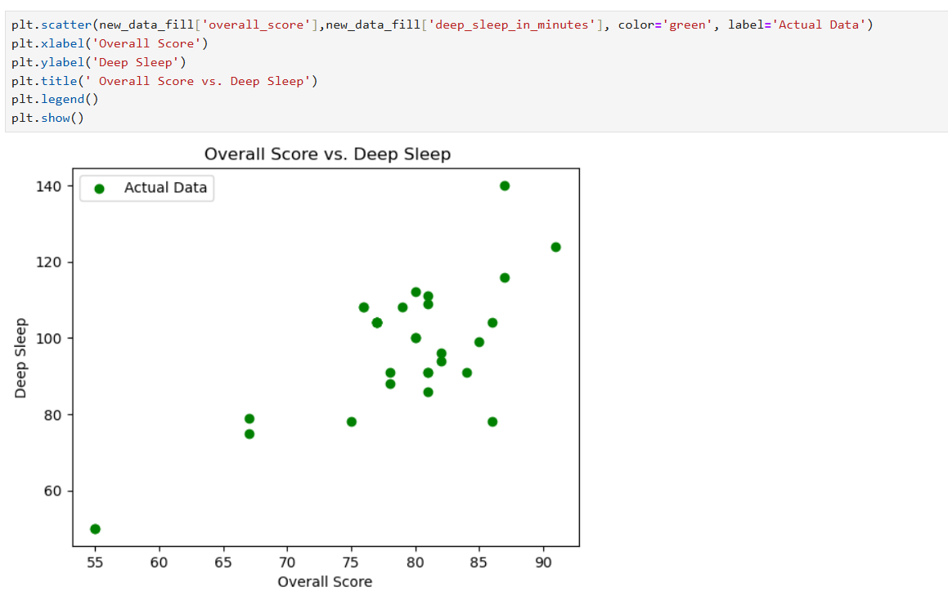
Scatter plot
We created a scatter plot between deep sleep and overall score
We can see that it has a strong linear relationship

Slide 16
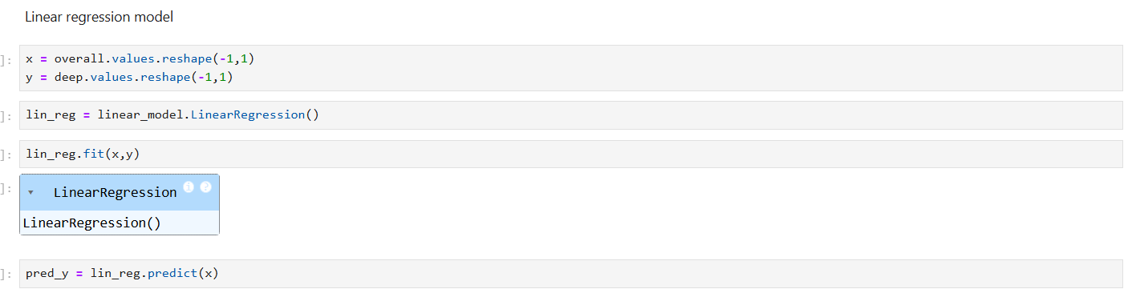
Linear regression model
We created a linear regression model to get the general idea of how this analysis work.

Slide 17
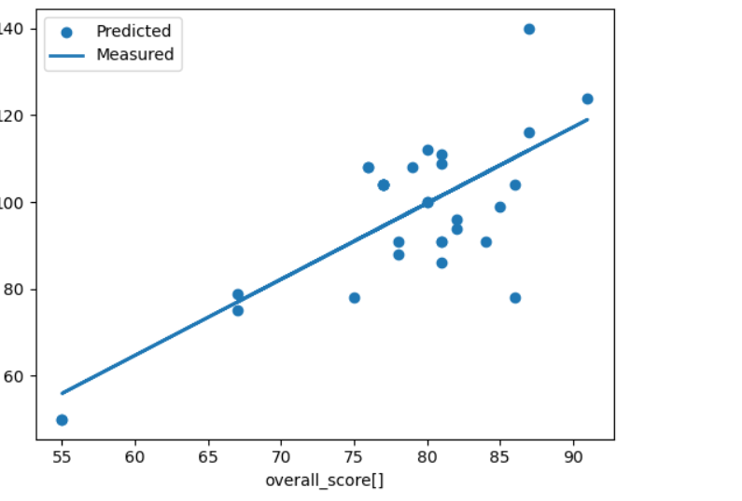
Scatter plot of the linear regression model.
trend of the line indicates the model's understanding of the relationship between overall score and deep sleep.
As overall score increases, the predicted deep sleep duration generally increases.

Slide 18
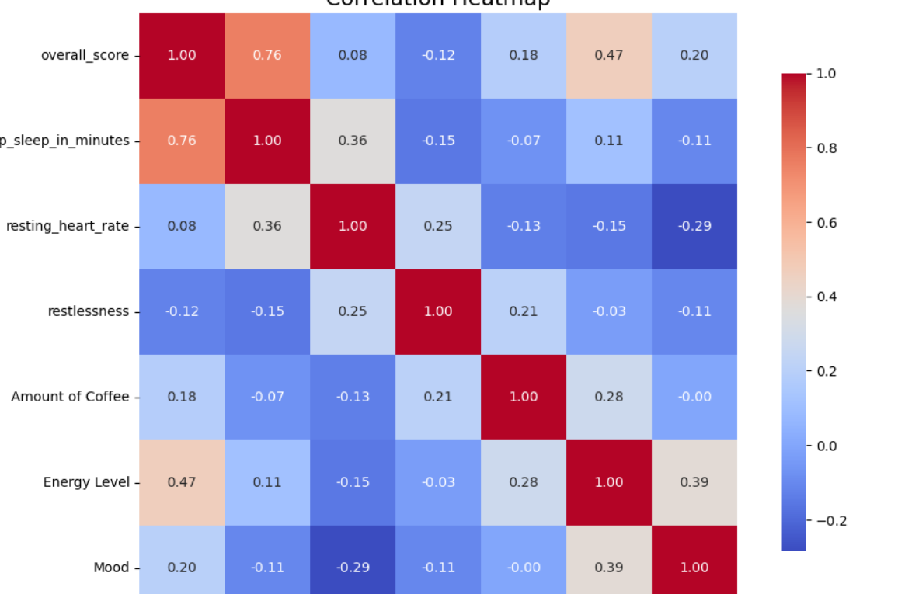
Heatmap of the fixed data
We can say that the fixed and unfixed data doesn’t change much in the data small differences

Slide 19
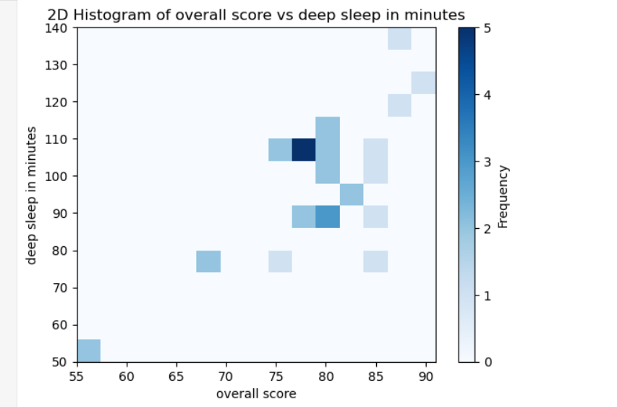
Histograms
The 2D histogram reveals a positive correlation between the overall score and deep sleep duration. Data points are mostly concentrated in the range of overall scores between 75 and 85, and deep sleep durations between 90 and 110 minutes. The highest frequency of data points occurs around an overall score of 80 and deep sleep of 100 minutes

Slide 20
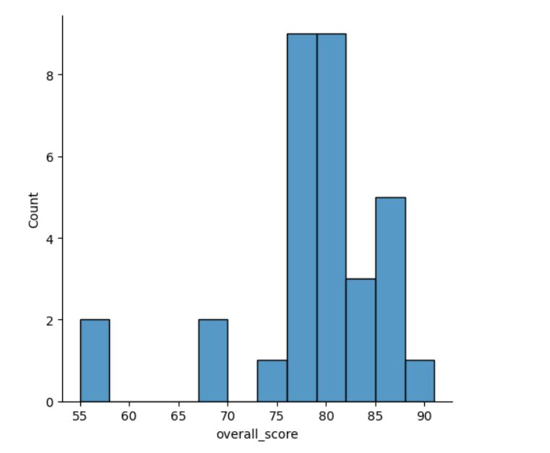
through this histogram we can conlcude that the data is centered between 75-90

Slide 21
Conclusion
We can say that there’s a strong relationship between overall sleep score and deep sleep in minutes.
As the deep sleep in minutes tend to increase it improves the sleep quality
Studies that confirm this https://www.healthline.com/health/how-much-deep-sleep-do-you-need

Slide 22

Questions

Slide 23

The end
This data analysis was conducted by:
Mahdi ahmad khries
Ahmad alzubani
Supervisor : د. دعاء الزالق

